Slide 1

QTP Output Values
Presented By:
Yogesh Tiwari
Guided By:
Utpal Sir & Krishna Sir

Slide 2
Prerequisites for Checkpoints
Having Knowledge of QTP
Having Knowledge of Scripting Language

Slide 3
Discussion Topics
What Is Output Values.
Types Of Output Values.
GUI Representations & Examples.
Way To Create Output Values.

Slide 4
What Is Output Values
“You can retrieve values from your test and store them in the data table as output values. You can subsequently use these values as an input parameter in your test. This enables you to use data retrieved during a test in other parts of the test. “
“Using Output values we can retrieve properties of objects ,database field values ,text presenting objects and can store on data table in test result window.”

Slide 5
Types Of Checkpoints
Standard Checkpoints
Bitmap Checkpoints
Text Checkpoints
Text Area Checkpoints
Accessibility Checkpoint
Database Checkpoint
XML Checkpoint

Slide 6
Standard Checkpoint
“Checks property values of an object in your application. “
For example –
Radio button is activated after it is selected or you can check the value of an edit box.

Slide 7
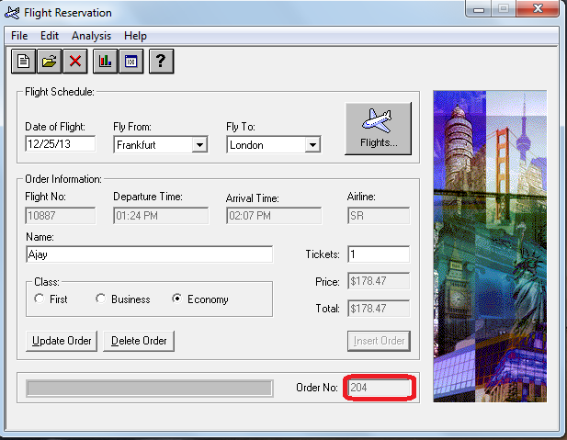
GUI Representation Of An Example
Create A Checkpoint on Order No.

Slide 8
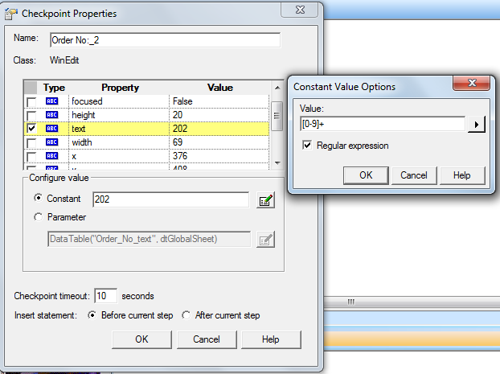
Example Continued…
Goto INSERT→CHECKPOINT→STANDARD CHECKPOINT.
In Active Screen Right Click On Order No Field and Select
STANDARD CHECKPOINT PROPERTIES Dialog Box Apears-

Slide 9
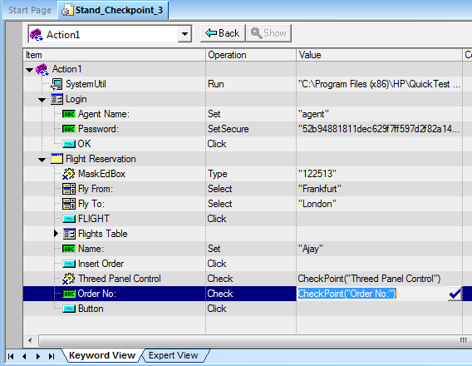
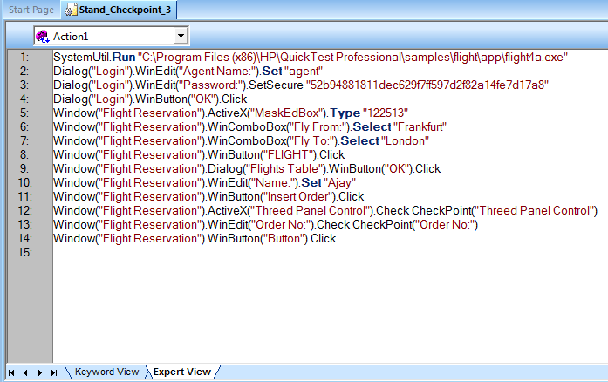
Example Continued…
We can also open Checkpoint Properties Dialog Box By Keyword View-

Slide 10
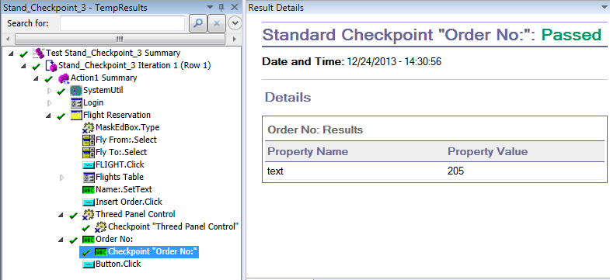
GUI Representation
After Run The Script We can Observe the Test Results.

Slide 11
Bitmap Checkpoint
Checks an area of your application as a bitmap.
For example-
Suppose you have a Web site that can display a map of a city the user specifies. The map has control keys for zooming. Using the bitmap checkpoint, you can check that the map zooms in correctly.

Slide 12
Text Checkpoint
Checks that a text string is displayed in the appropriate place in an application.
For example –
Suppose a Web page displays the sentence Flight departing from New York to San Francisco. You can create a text checkpoint that checks that the words "New York" are displayed between "Flight departing from" and "to San Francisco.

Slide 13
Text Area Checkpoint
Checks that a text string is displayed within a defined area in a Windows-based application, according to specified criteria.
For example –
Suppose your Visual Basic application has a button that says View Doc <Num>, where <Num> is replaced by the four digit code entered in a form elsewhere in the application. You can create a text area checkpoint to confirm that the number displayed on the button is the same as the number entered in the form.

Slide 14
Accessibility Checkpoint
Identifies areas of your Web site that may not conform to the World Wide Web Consortium (W3C) Web Content Accessibility Guidelines.
For example –
W3C Web Content Accessibility Guidelines requires you to provide a text equivalent for every non-text element. You can add an Alt property check to check whether objects that require the Alt property under this guideline, do in fact have this tag.

Slide 15
Database Checkpoint
Checks the contents of a database accessed by your application.
For example –
you can use a database checkpoint to check the contents of a database containing flight information for your Web site.

Slide 16
XML Checkpoint
Checks the data content of XML documents in XML files or XML documents in Web pages and frames.

Slide 17
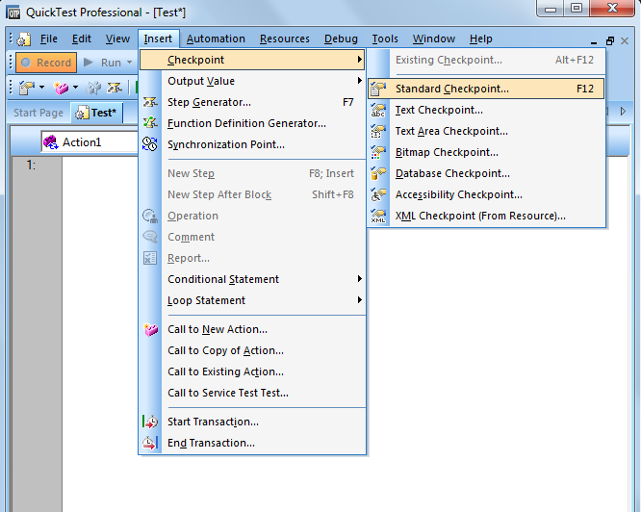
Ways To Create Checkpoints
We can create a checkpoint at the recording time of application.
Goto Insert Menu→Checkpoints→Then Select the type of Checkpoint.

Slide 18
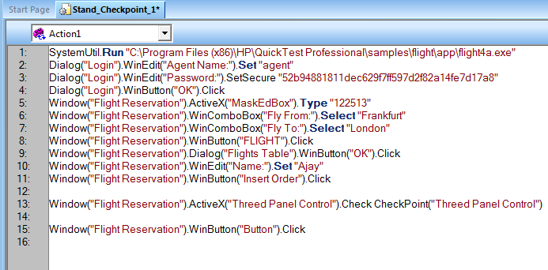
Ways To Create Checkpoints…
2. We can create Checkpoint by Expert view.
We have to put here manualy by code-

Slide 19
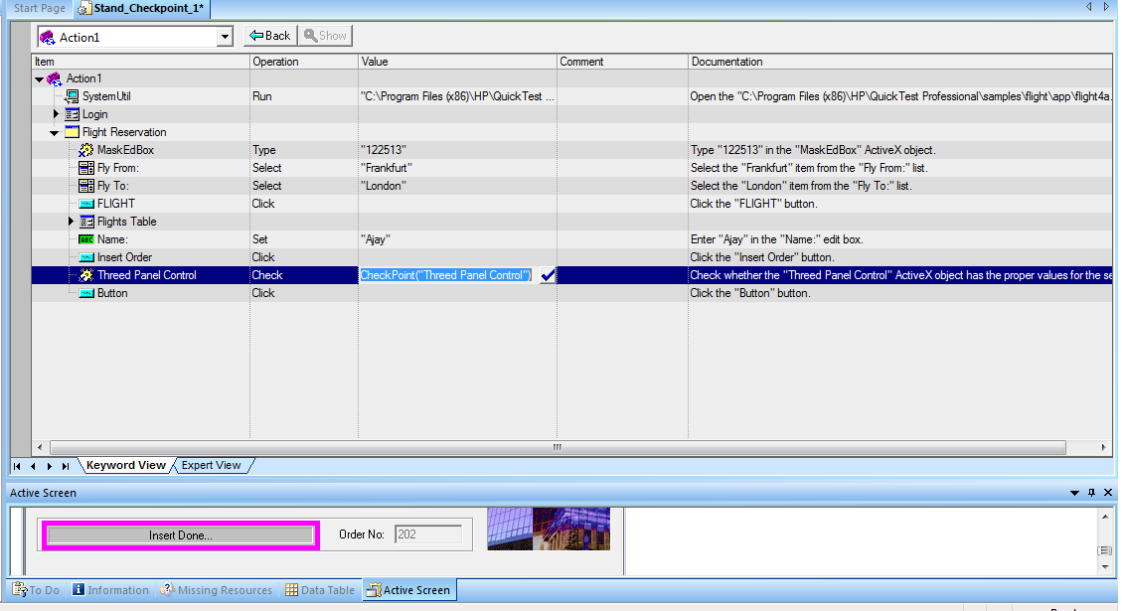
Ways To Create Checkpoints…
3. We can create Checkpoint by Keyword View.
Goto Keyword view Select Object→Click Value Coloumn of Object

Slide 20
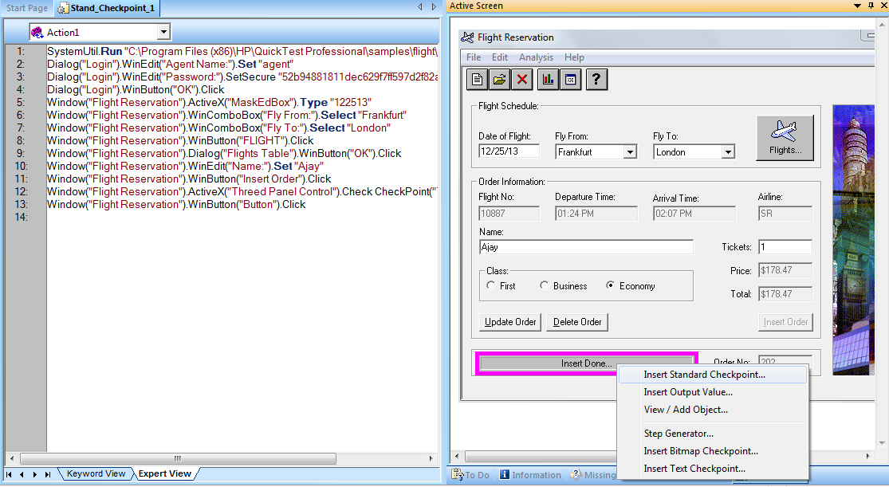
Ways To Create Checkpoints…
4. We can create Checkpoint by Active Screen Also.
Right click on object.

Slide 21
Thanks

